Slide 1
EU Hertz – Campaign Performance Q4 2013
January 2014

Slide 2
Performance by Audience
Targeting | Impressions | Clicks | CTR | Conversions | Cost | CPA
Homepage Retargeting | 2,358,071 | 915 | 0.04% | 5,291 | £2,774.20 | £0.52
Converter Re-engagement | 406,537 | 98 | 0.02% | 778 | £478.28 | £0.61
Search Retargeting | 1,504,173 | 704 | 0.05% | 1,807 | £1,769.62 | £0.98
Smart Retargeting | 30,828 | 18 | 0.06% | 29 | £108.80 | £3.75
Hotel Confirmation | 1,535 | 1 | 0.07% | 1 | £5.42 | £5.42
Sojern Private Marketplace | 2,768,344 | 1,041 | 0.04% | 658 | £9,770.63 | £14.85
Car Search | 38,856 | 23 | 0.06% | 8 | £137.14 | £17.14
Hotel Search | 57,043 | 29 | 0.05% | 10 | £201.33 | £20.13
Clicker Retargeting | 292,103 | 517 | 0.18% | 29 | £787.64 | £27.16
3rd Party Data | 750,788 | 181 | 0.02% | 66 | £2,649.84 | £40.15
Flight Confirmation | 24,149 | 9 | 0.04% | 2 | £85.23 | £42.62
Flight Search | 1,879,131 | 942 | 0.05% | 134 | £6,632.23 | £49.49

Slide 3
Top Sites
Highlights
Top Sites (Filtered by Traffic Levels)
youtube.com
dakinemedia.net*
planespotters.net
opodo.de
ownersdirect.co.uk
ebay.de
tfl.gov.uk
tvguide.co.uk
flyertalk.com
anonymousgoogle.com*
autotrader.co.uk
flightstats.com
hostelworld.com
reed.co.uk
192.com
autoexpress.co.uk
mysupermarket.co.uk
vielfliegertreff.de
aero.de
ebay.fr
+
27% of the total campaign impressions were served across these sites.
These top 20 Sites drove 13% of total conversions.
*Blind Network Inventory
+
Notes:
We should combine “Yahoo sites” and “Microsoft sites” as one. “Yieldmanager.com” is really Yahoo! too.
What is primesite-2?

Slide 4
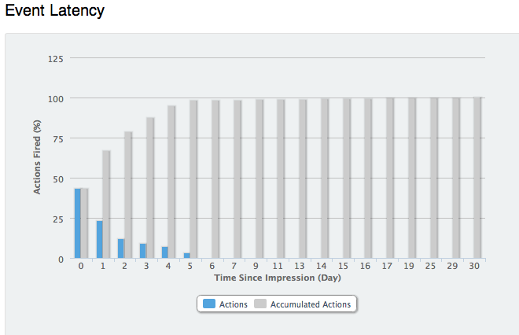
Booking Window Insight
Highlights
+
It takes 2 days after an impression to account for the majority of resulting conversions.
65% of conversions happen either on the same day, or on the next.
+
Notes:
Nice way to show the long tail!

Slide 5
France - Performance by Hour
Highlights
+
The top hour of the day for reservations was 11 a.m.
The worst hour of the day for reservations was 4 a.m.
+
Notes:
Can you find a source of US Internet traffic (maybe from comScore) that shows US Internet traffic by hour?
What do you think the story is here?? Should you still advertise at 4am?
What’s the conversion rate by hour???

Slide 6
Germany - Performance by Hour
Highlights
+
The top hour of the day for reservations was 11 a.m.
The worst hour of the day for reservations was 4 a.m.
+
Notes:
Can you find a source of US Internet traffic (maybe from comScore) that shows US Internet traffic by hour?
What do you think the story is here?? Should you still advertise at 4am?
What’s the conversion rate by hour???

Slide 7
UK - Performance by Hour
Highlights
+
The top hour of the day for reservations was 3 p.m.
The worst hour of the day for reservations was 3 a.m.
+
Notes:
Can you find a source of US Internet traffic (maybe from comScore) that shows US Internet traffic by hour?
What do you think the story is here?? Should you still advertise at 4am?
What’s the conversion rate by hour???

Slide 8
Performance by Ad Size
Highlights
Creative Size | Impressions | % Impressions | CTR | Reservations
EU Hertz - 160x600 | 2,033,558 | 20% | 0.047% | 1,355
EU Hertz - 300x250 | 3,511,649 | 35% | 0.053% | 3,537
EU Hertz - 728x90 | 4,566,351 | 45% | 0.036% | 3,921
+
The 728x90 had the lowest CTR overall however drove the most reservations.
The 300x250 had the highest impression to reservation ratio. This unit also achieved the highest CTR.
+
Notes:
I removed click data – since that’s not how we’re measured -- nor does it reflect the value of what we do

Slide 9
Impressions & Reservations by Month
Highlights
+
Sojern delivered the greatest number of impressions during the month of December.
Sojern delivered the greatest number of reservations during the month of November.
+
Notes:
Pretty cool!

